Slide 1
Indivisible in OC – DISTRICT 45
Resist – Persist - Activist

Slide 2
Today’s agenda
Review of Indivisible CA-45 actions in April
Lessons learned from the “Resistance Lab”
Voter Registration
Safety at rallies/ protests
Organizing for May

Slide 3
What we did in april
April 4: Derek Tran’s office opening ceremony
Continued weekly Monday evening rallies
April 3: Steering Committee met with Rep. Derek Tran in his district office
April 5: “Hands Off” rally in Santa Ana

Slide 4
More in april
April 13: “Resistance Lab” with Pramila Jayapal
April 19: “No Kings” rally in Yorba Linda
April 21 and 22: Town Halls with Congressman Derek Tran
April 12: Bernie and AOC in Los Angeles

Slide 5
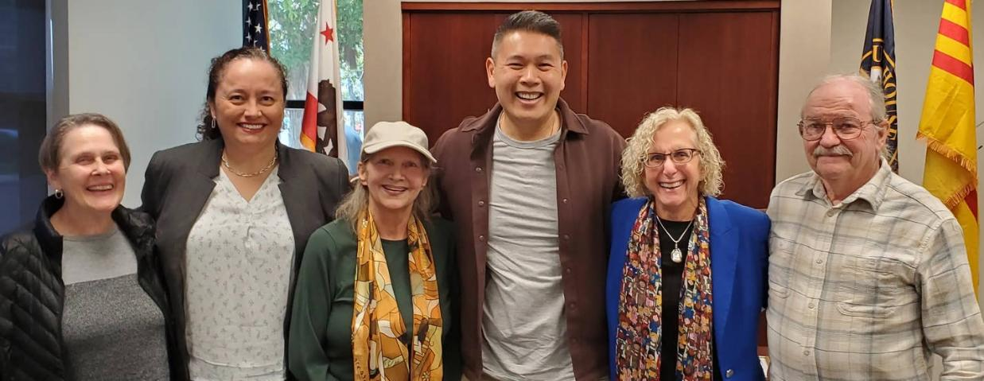
indivisible CA-45 meets with Congressman Derek tran

Slide 6
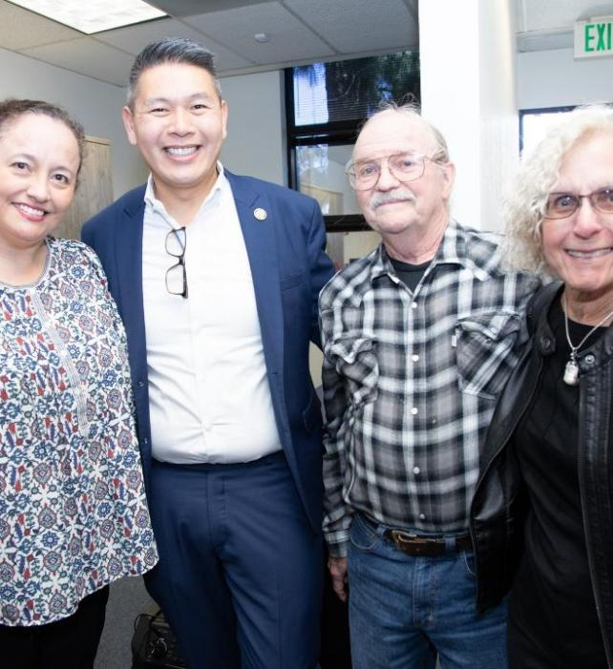
Congressman Derek tran’s district office opening

Slide 7
April 5th “hands-off” rally

Slide 8
Bernie & aoc come to los angeles

Slide 9
April 19: “no kings” rally

Slide 10
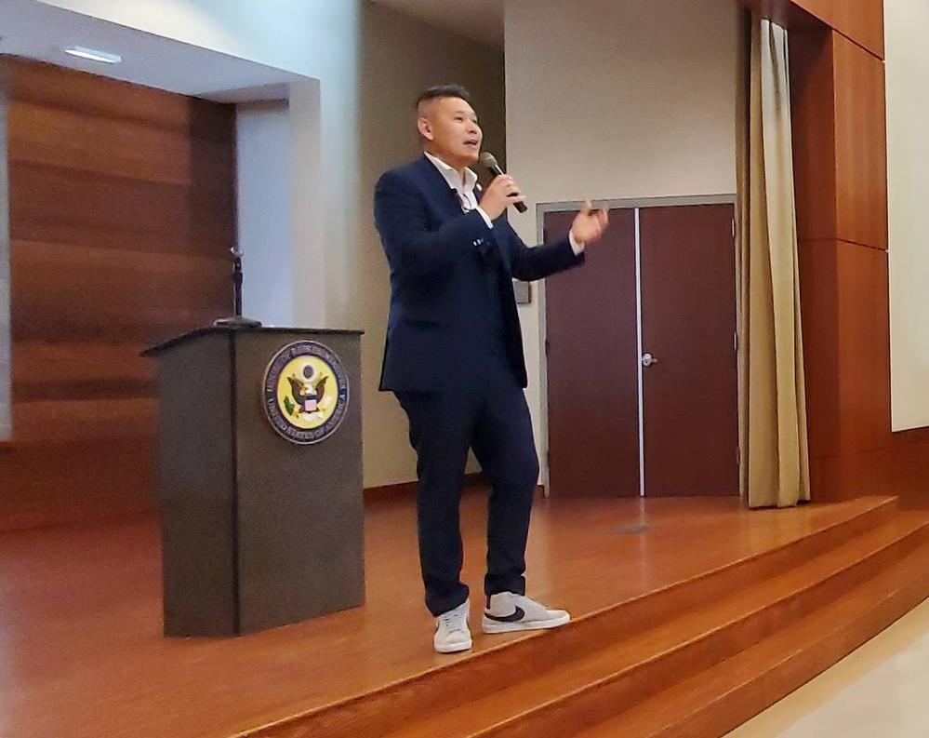
Town halls with Rep. Derek tran

Slide 22
Next Resistance Labs
May 4th – Resistance Lab-201
June 1st – Resistance Lab-101
PramilaForCongress.com

Slide 23
Voter registration - Bill Niemand co-lead of College Voter Registration with Swing Left Inland Valley

Slide 24
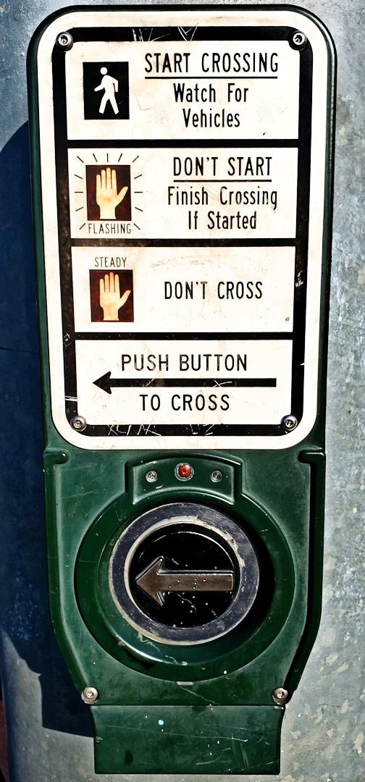
Safety at protests/ rallies
Santa Ana Hands Off Rally
BREA
Notes:
TALK ABOUT BREA, INDIVISIBLE GUIDANCE, MORE ONLINE

Slide 25
CROSS CLOCKWISE USE THE CROSSWALK ON YOUR LEFT
START ON WHITE SIGN LOOK BEFORE WALKING
DON’T START ON FLASHING LIGHT WAIT FOR THE NEXT CYCLE Keep the Ramps Clear Stay Safe Have sympathy for the commuters
Notes:
TALK ABOUT BREA, INDIVISIBLE GUIDANCE, MORE ONLINE

Slide 26
A core principle behind all Indivisible events is a commitment to nonviolent action.
We expect all participants to seek to de-escalate any potential confrontation.
Hosts are expected to ensure all participants in your event uphold this commitment.

Slide 27
We recommend all participants review our safety and security resources:
INDIVISI.org/safety

Slide 28
Non-engagement with Hostile Individuals: If approached by someone aggressive, avoid engaging and keep a safe distance.
Remain Calm and Be Observant: Stay aware of your surroundings.
Maintain a non-threatening Stance: Use calm body language. Maintain personal space. Use neutral facial expressions and gestures. Keep your hands low.

Slide 29
Rights of Assembly: Public spaces are protected for public demonstrations. You can legally photograph or video anything in plain view, including police actions.
Notify Law Enforcement of our plans: To establish trust with local police who are supportive of de-escalation.

Slide 30
Orders to Disperse - Comply Calmly:
Police must provide a clear dispersal order, must provide sufficient time to leave, and must provide a safe exit route. Follow dispersal instructions calmly.
Stay Calm and Composed:
Move slowly and avoid arguing or resisting police.

Slide 32
May 1st – -"May Day Strong" Orange City Hall 12-1PM - ocmdc.org El Centro Cultural De Mexico Santa Ana 3:30 – 7:30pm
May 4th – Resistance Lab 201 – online - May the 4th Be With You 2-4PM @ IRVINE CITY HALL
May 17th – 2-3:30PM rally at Nixon Library
May 21st – Postcard party
May 31st – Indivisible CA-45 meeting, same place, same time
Continued Monday evening rallies in Brea

Slide 33
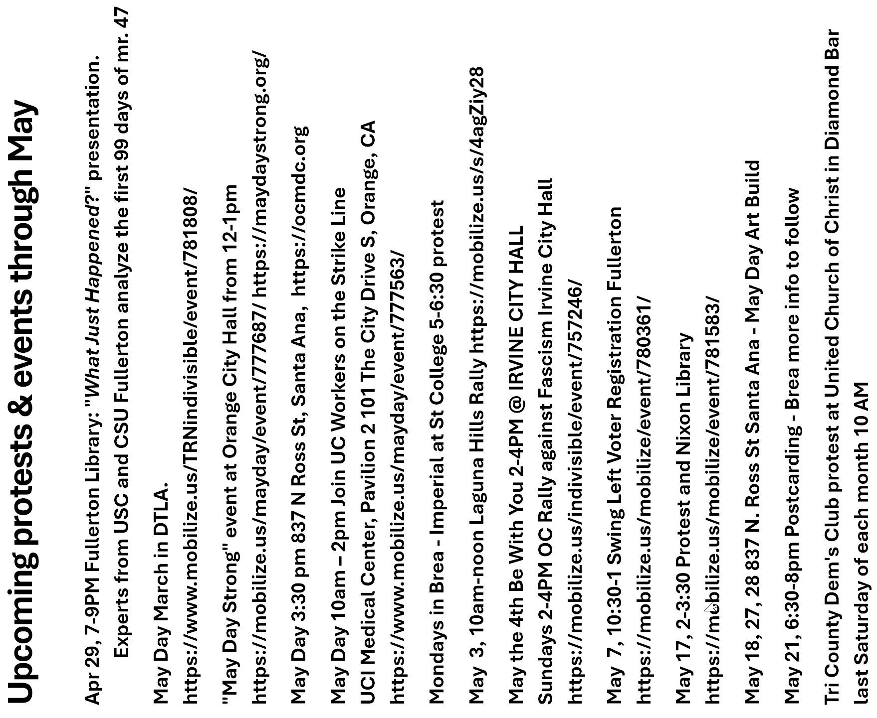
Pick up this Flyer in the lobby.

